Slide 1
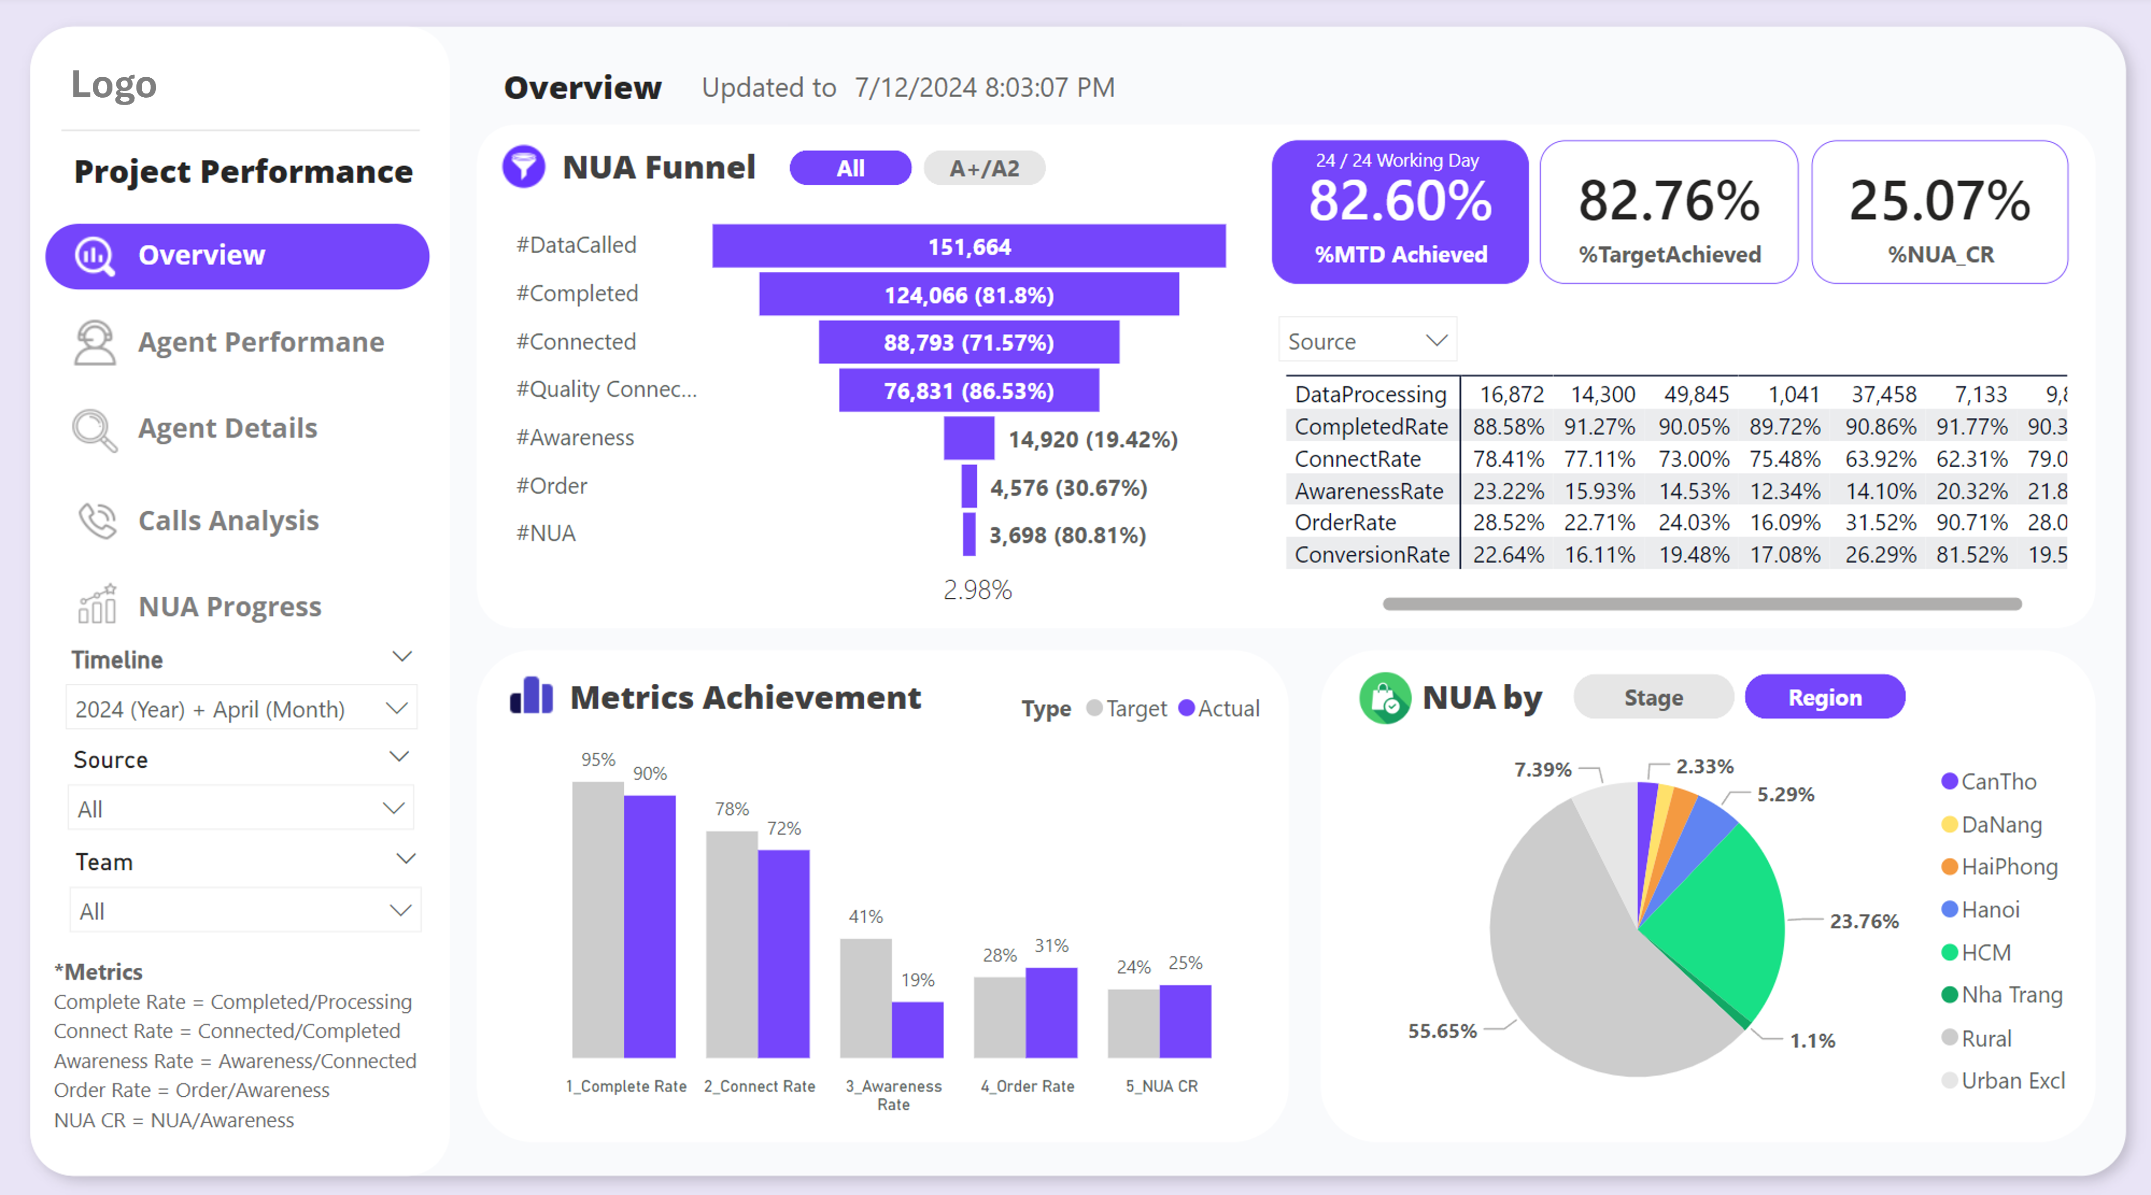
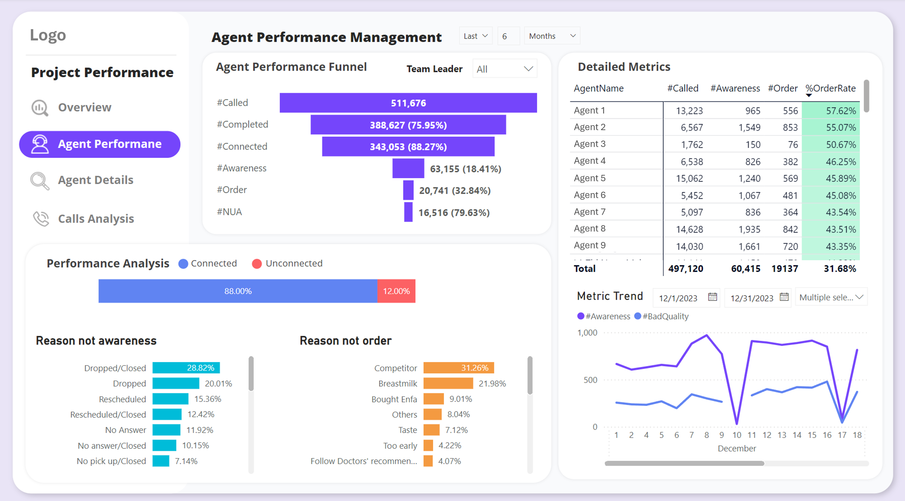
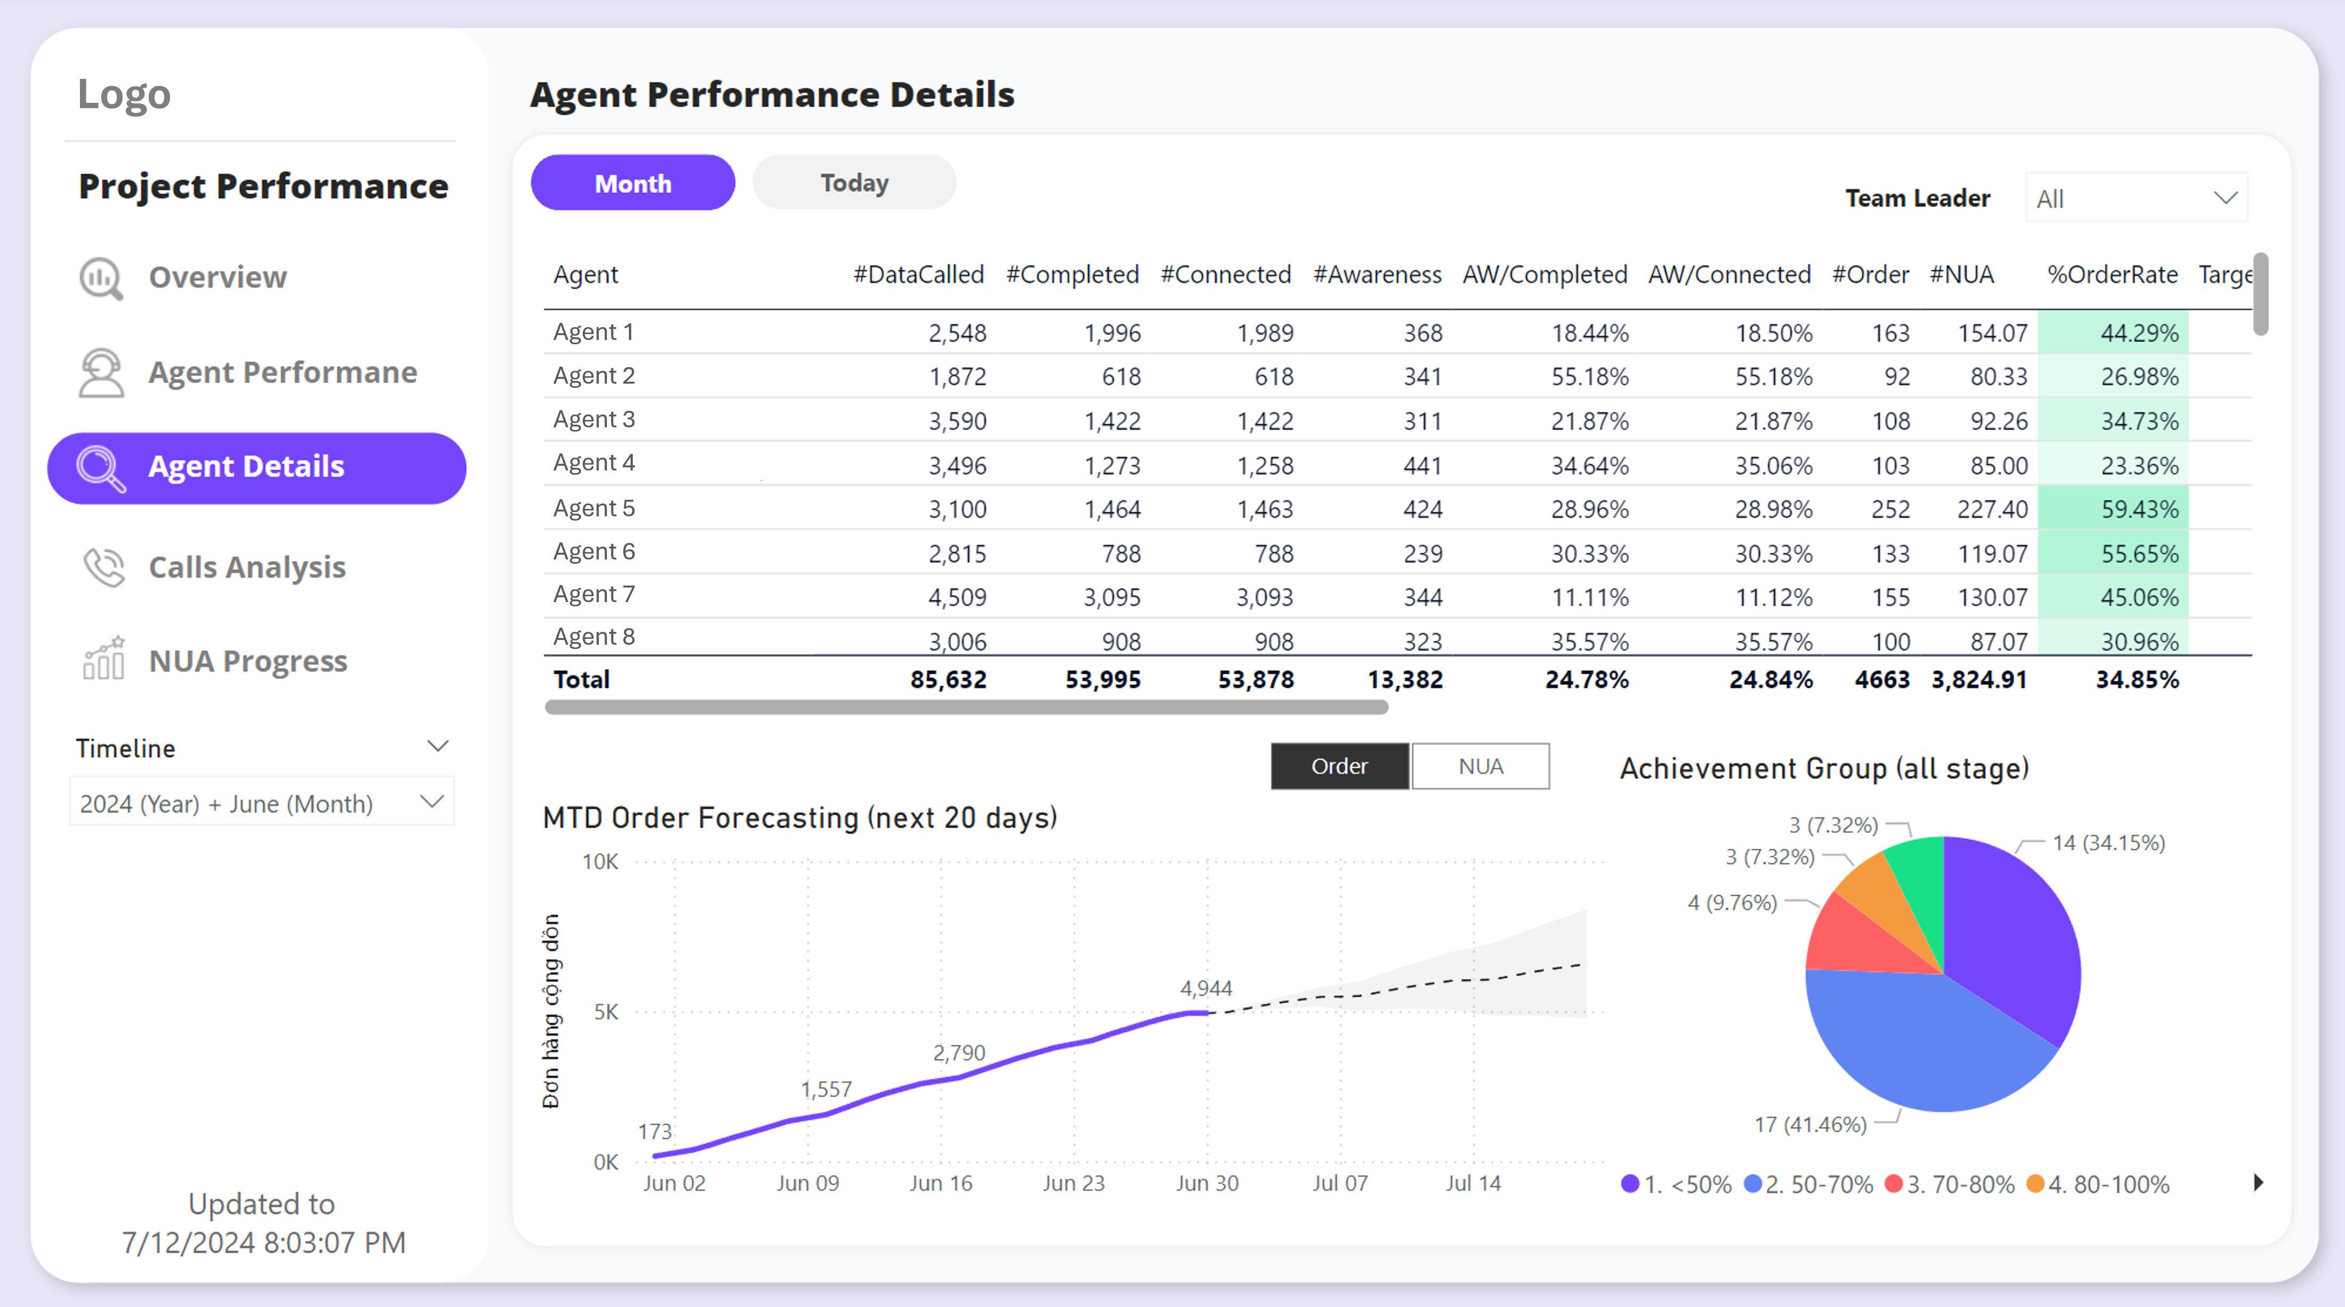
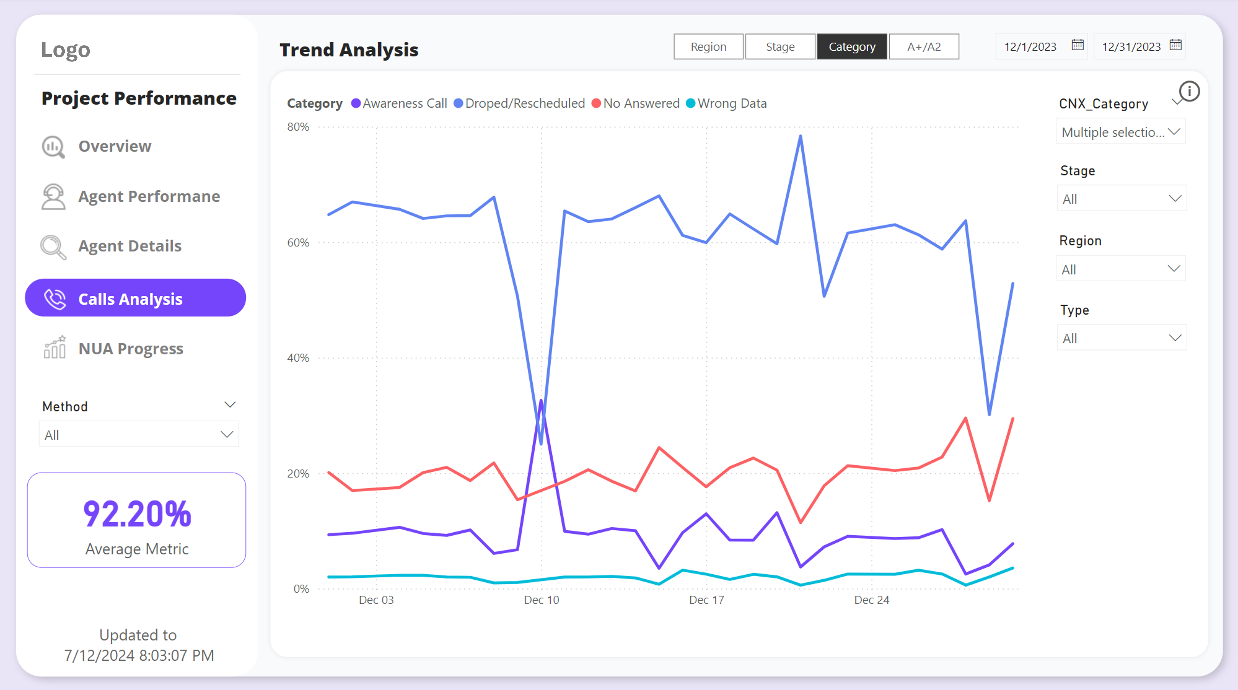
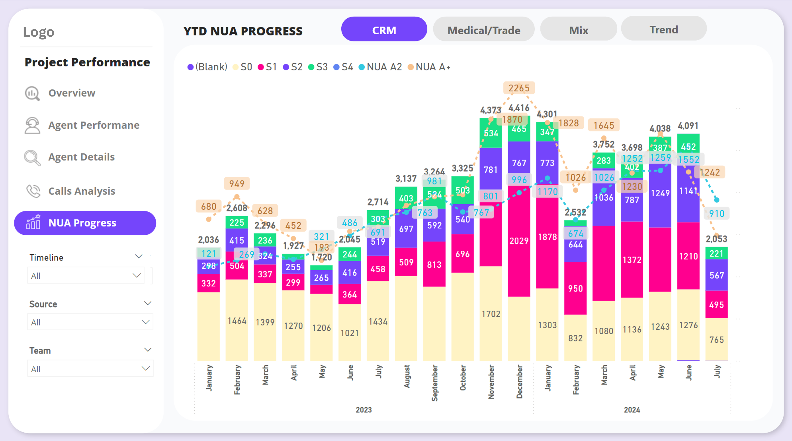

Slide 2

Logo

Slide 3

Logo
Agent 1
Agent 2
Agent 3
Agent 4
Agent 5
Agent 6
Agent 7
Agent 8
Agent 9

Slide 4
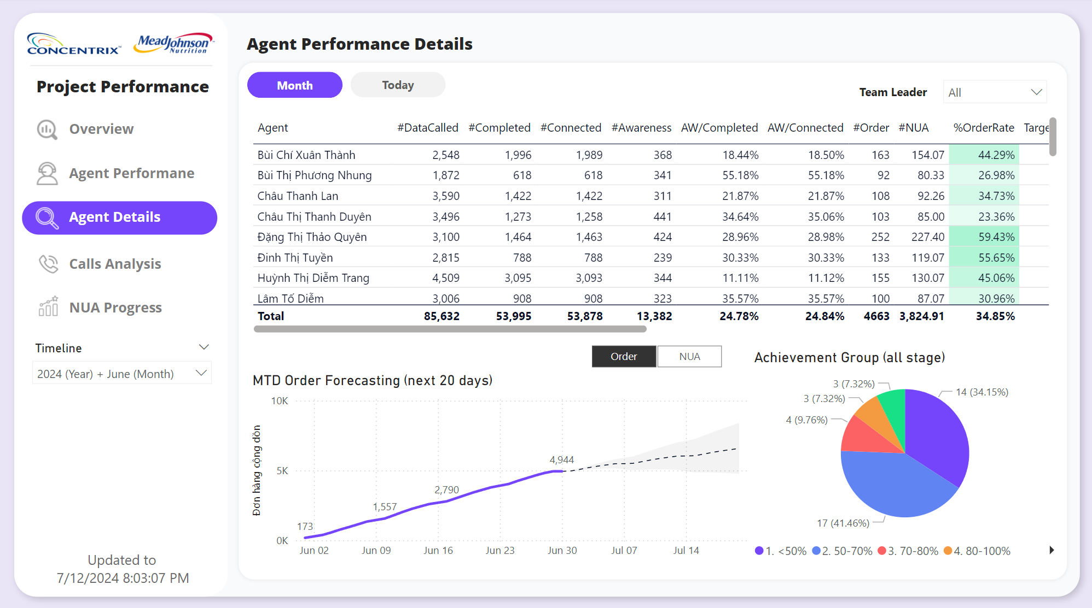
Logo
Agent 1
Agent 2
Agent 3
Agent 4
Agent 5
Agent 6
Agent 7
Agent 8

Slide 5
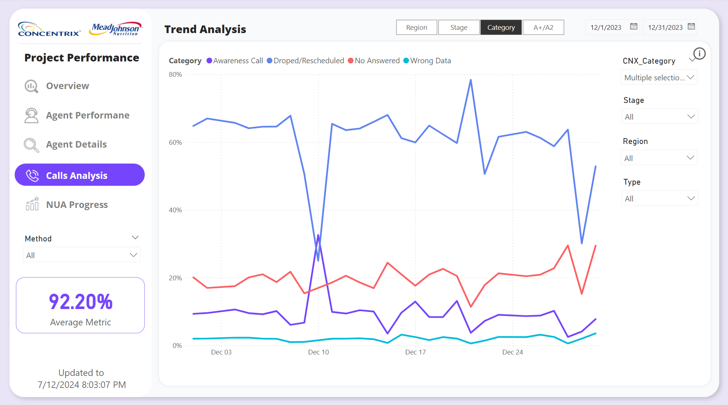
Logo

Slide 6

Logo

